Slide 1
Computer Systems & Networks Assignment 2
Project Flowchart Presentation
Naoise O’Sullivan - 20091403
Please run the slideshow for a demonstration of logical flow paths for the project

Slide 2
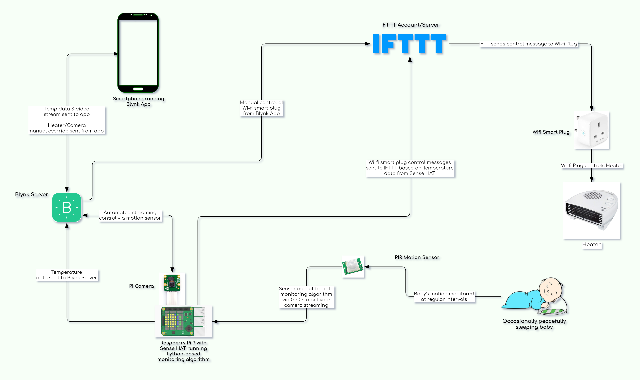
Manual control of Heater from Blynk App
Baby’s motion triggers video stream
Sense HAT Temp Sensor controls Heater
Temp Data Sent to Blynk App
Manual Video Stream activation

